Slide 1

Unlocking Insights for a Safer City: LAPD Data Analytics
Group 10
Ballarat Analytics Group (BAG) Harison Nagisvaran
Student 2
Student 3

Slide 2
Introduction
Dataset
BI Dashboard Solution
Analysis visuals + Findings
Conclusion

Slide 3
Introduction
Purpose: Gain insight of dataset to combat rising crime rates in Los Angeles
Dataset Highlights: Origin: LAPD Reports Timeframe: Jan 2020 to July 2023 Size: 803,000 rows, 28 columns
Key insights: Uncovering Crime patterns Victim demographics Crime hotspots

Slide 4
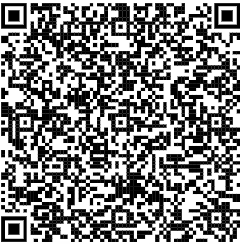
BI Solution
Solution | Purpose | Key Audience(s)
Executive Dashboard | Designed to provide high-level insights and key performance indicators (KPIs) | Senior law enforcement executives Police Chief City Officials
Operational Dashboard | To assist field officers in real-time incident monitoring and patrol optimization | Patrol officers Field personnel
Community Engagement | To engage LA residents and neighbourhood watch groups with safety information and updates | Community members Neighbourhood watch groups

Slide 5
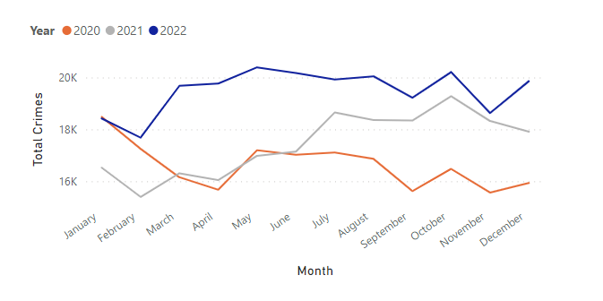
Yearly Comparative Analysis (Excel)
Findings:
Total number of crime increasing annually from 2020
Implications:
Strengthen crime prevention strategies
Source: Author

Slide 6
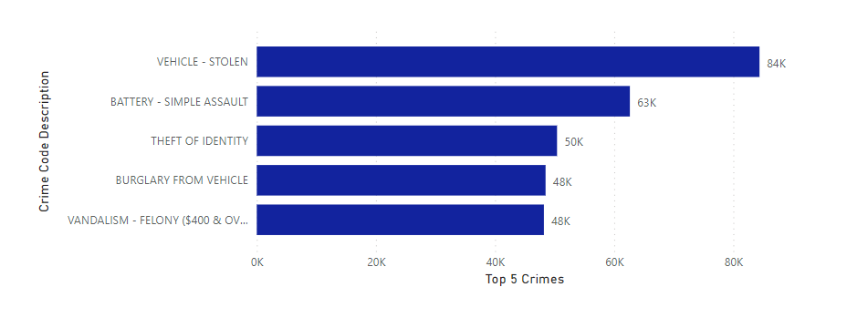
Top 5 Crimes (PowerBI)
Findings:
Highest crime committed in Los Angeles was stolen vehicle and assault.
Implications:
Prioritize the allocation of resources and budget towards addressing stolen vehicle cases and assault-related incidents.
Source: Author

Slide 7
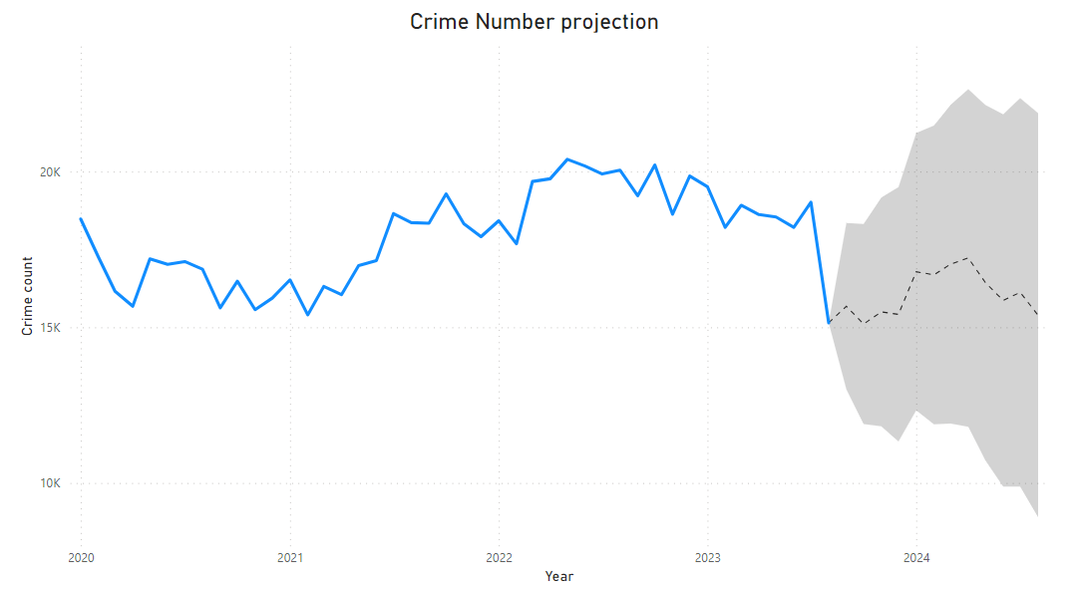
Crime Number Projection (PowerBI)
Findings: Anticipate an increase in criminal activities over next 12 months.
Implications: Increase crime prevention strategies E.g. CCTV, Patrol officers etc
Source: Author
Notes:
Thank you Paul. Gd afternn everyone, in the next few slides, you will see how we used other analysis tools to uncover valuable insights within the dataset. The line chart provides a predictive view of future crime trends using statistical modelling and forecasting. Evidently, it illustrates an upward trajectory in the number of reported crimes over the next six months, extending into 2024. The chart employs historical crime data and applies advanced forecasting techniques to generate this projection as seen in the dotted line. Coming to the implications, this visual provides valuable insights for law enforcement and decision-makers, enabling them to anticipate and prepare for potential increases/decrease in crime rates and then allocate their resources effectively.

Slide 8
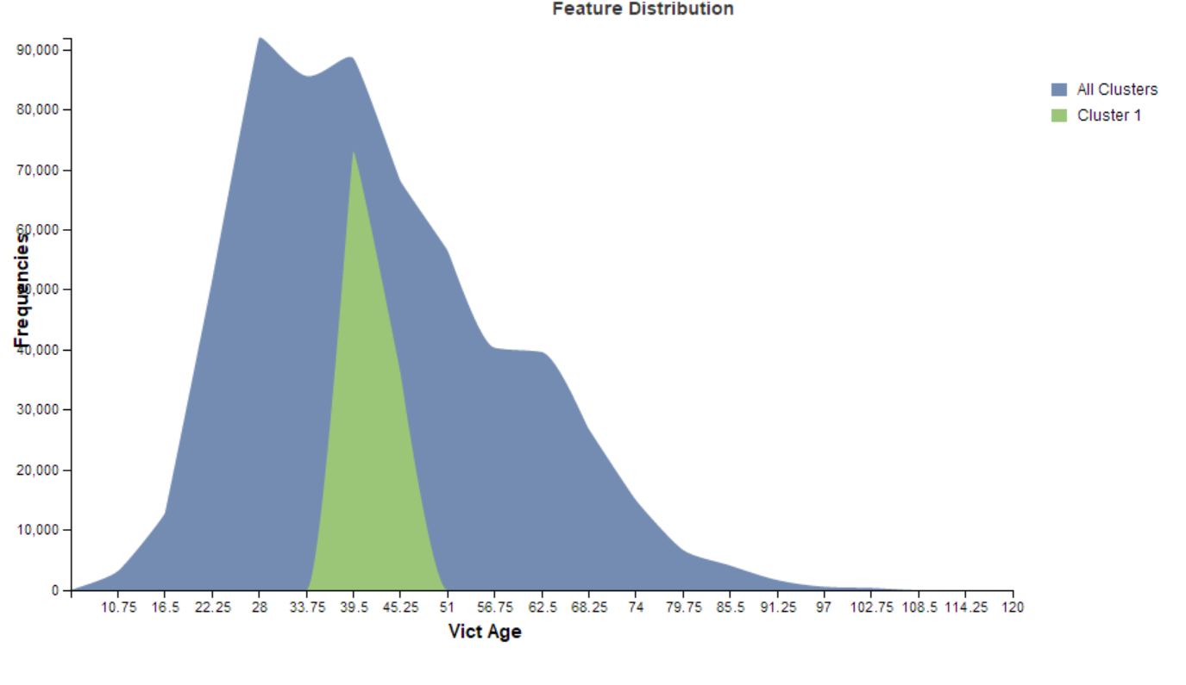
Age distribution of Crime Victims (SAP PA)
Findings: Distinct subgroup of victims aged 33 to 51.
Implications: Focus efforts on this cluster by optimizing deployment of law enforcement in respective suburbs.
Source: Author
Notes:
Next, we have used the prediction capabilities of SAP Predictive analytics. Utilizing advanced clustering algorithms, we've uncovered a noteworthy finding within the dataset. A distinct subgroup of victims aged between 33 to 51 years, has emerged.
Implication: This discovery carries substantial implications for our policing strategies. We recommend focusing our resources on this specific age cluster, we can optimize our deployment of law enforcement personnel across various neighborhoods and suburbs with this This targeted approach will enhance our ability to address and prevent crime more effectively.

Slide 9
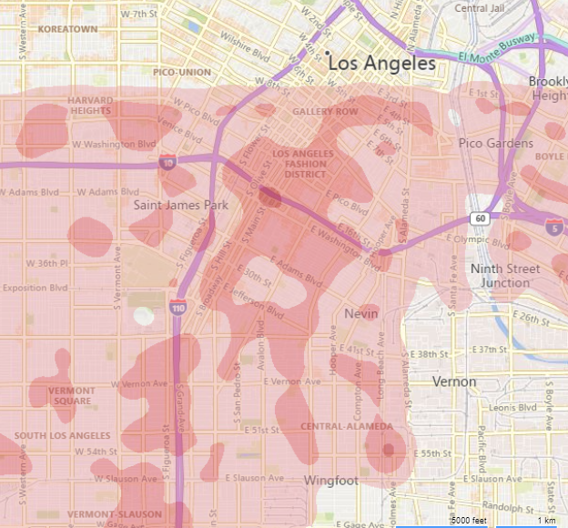
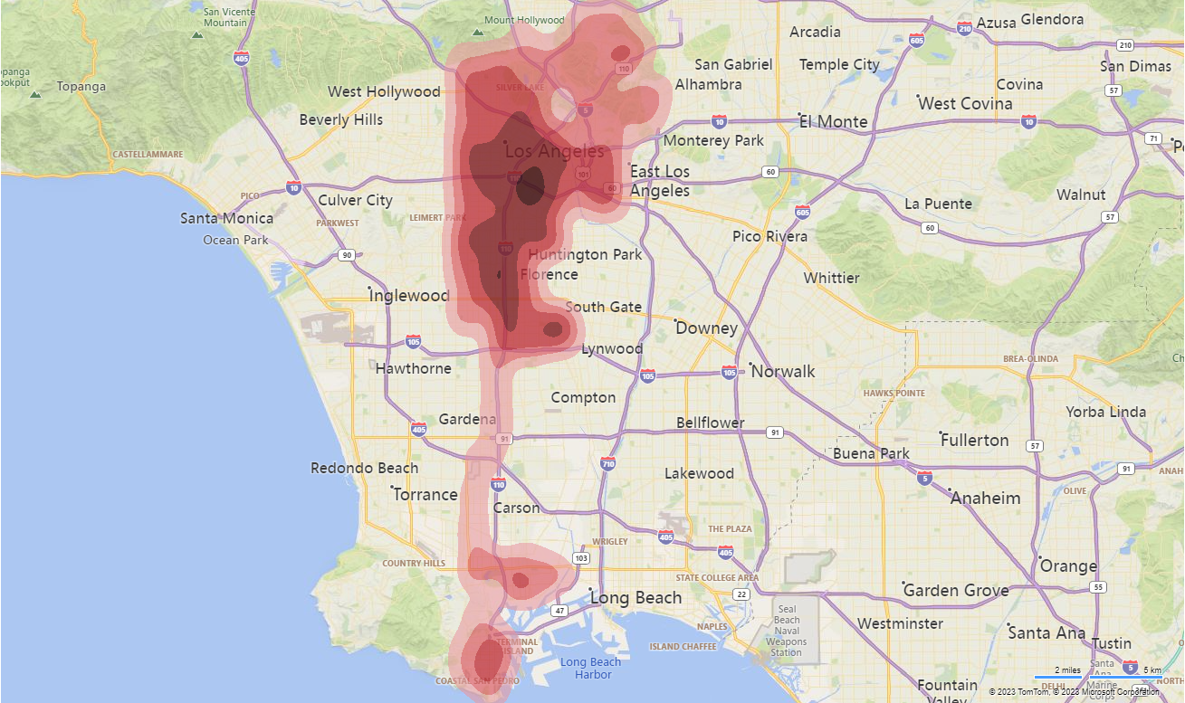
Crime density Heatmap (PowerBI)
Findings: High and low crime zones identified. E.g. Los Angeles Fashion District , Jefferson Boulevard etc
Implications: Optimize deployment of law enforcement personnel
Source: Author
Notes:
Through the use of PowerBI's heatmap visualization, we’ve uncovered significant findings. We've successfully identified both high and low crime zones within our dataset. For instance, areas like the Los Angeles Fashion District and Jefferson Boulevard stand out as high crime zones. These findings hold profound implications for our law enforcement strategies. To maximize the effectiveness in preventing and addressing crime, we recommend increasing the deployment of law enforcement personnel in these identified high crime zones.

Slide 10
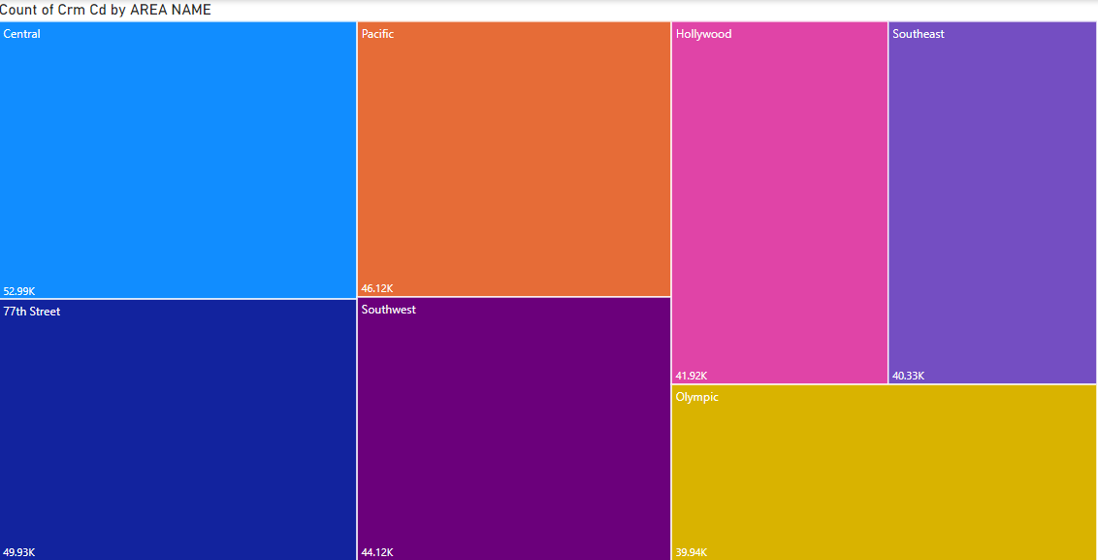
Crime Distribution by Area (Power BI)
Findings
The graph illustrates how crime is distributed by area in 4 years. The figure shows that the Central part of Los Angeles has the highest crime recorded with 52,990 cases.
Implications:
Resource allocation
Source: Author

Slide 11
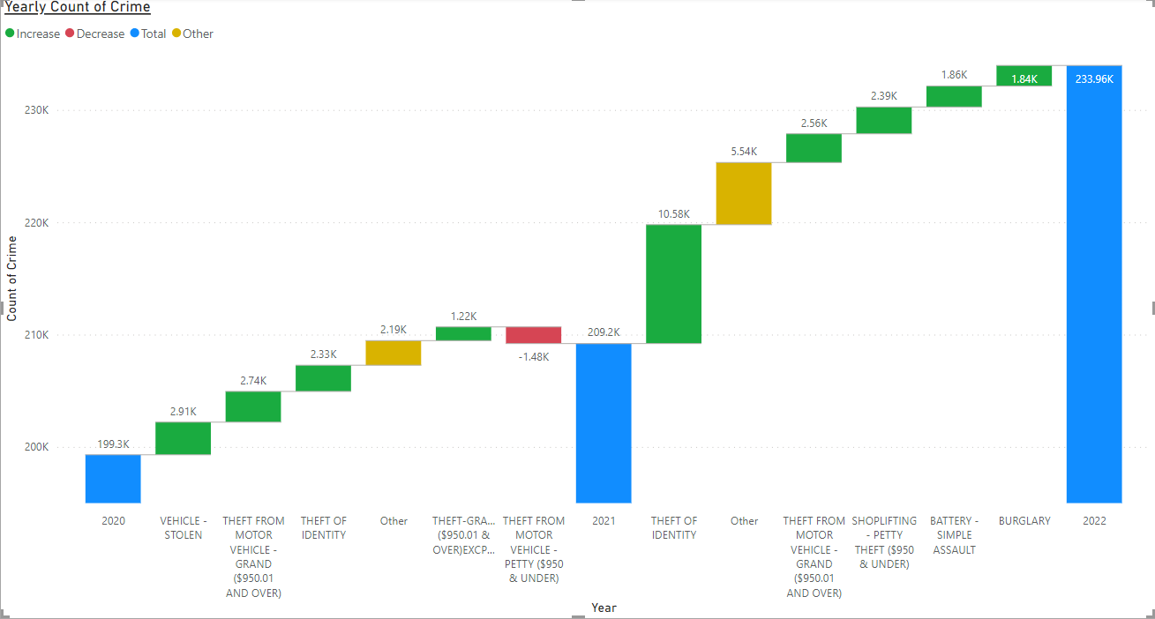
Yearly Count of Crime (Power BI)
Findings:
From 2020 to 2021 there was a relevant increase in vehicle stolen by 2,910 cases, while theft related to Motor vehicles with less than $950 decreased by 1,480
From 2021 to 2022 the figures related to Identity theft increased rapidly by 10,580 cases.
Implication:
Insights about the shift of crime pattern can help for strategic planning
Source: Author

Slide 12
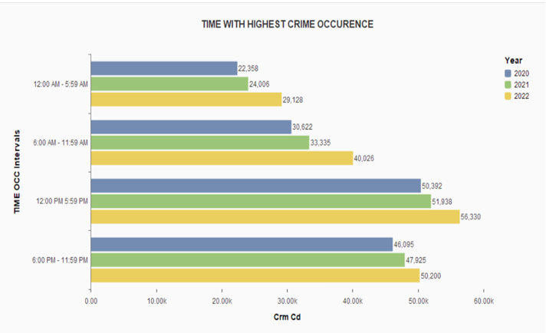
TIME WITH HIGHEST CRIME OCCURRENCE (SAP Lumira)
Finding: The graph shows the time pattern of crime committed in Los Angeles, California. From 2020 to 2022 the trend of crime follows the same pattern. It shows that from 12:00 PM to 11:59 PM most crime occurs. Implication: community awareness and improve police operation.
Source: Author

Slide 13
Conclusion
Highlight: Our analysis has provided valuable insights into crime patterns, spatial and temporal trends, and victim demographics.
Impact: These insights can inform targeted policing efforts, resource allocation, and crime prevention strategies.
Commitment: LAPD must leverage data analytics to enhance public safety and serve our communities better.

Slide 14
Q&A

